Slide 1
Weather Ready Pacific
BRAND

Slide 2
Our steps
Once we have finalised the logo we will build our wider brand package:
Logo user guidelines – what you must honour when you apply our logo
Motifs – pulled from the elements of the logo
Virtual backgrounds – created from motifs and colour schemes of the logo
Letterheads – inspired by the motifs and colour schemes of the logo
Powerpoint templates – built upon the components of the logo

Slide 3
Selecting our Weather Ready Pacific Logo
Selection by anonymous vote
Upon completion of the logo presentation you will be provided with a ballot to vote.
We seek your selection from the two options provided.

Slide 4
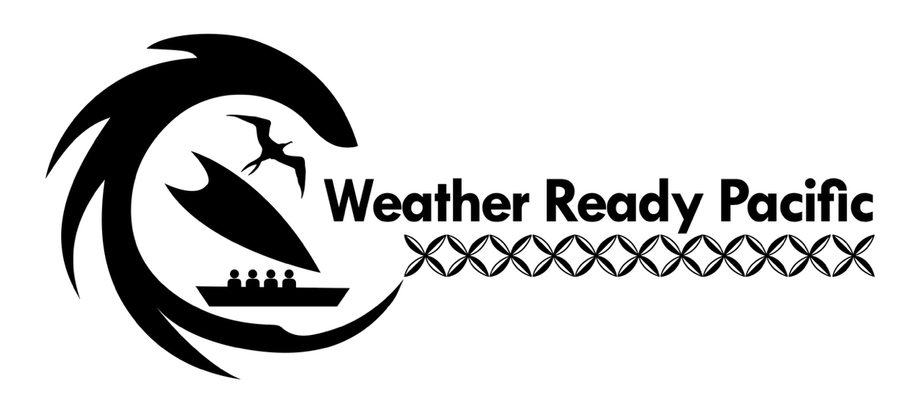
Option one – black and white

Slide 5
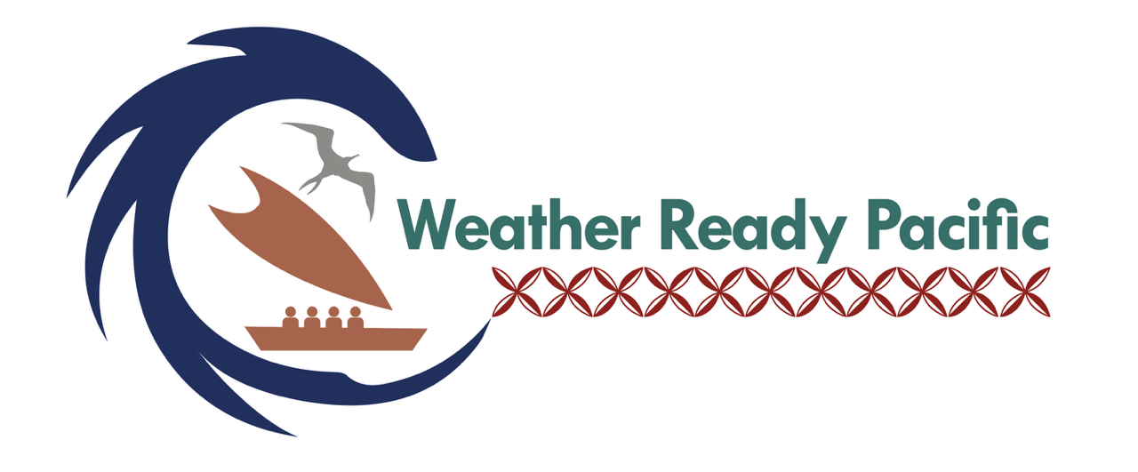
Option one – colour

Slide 6
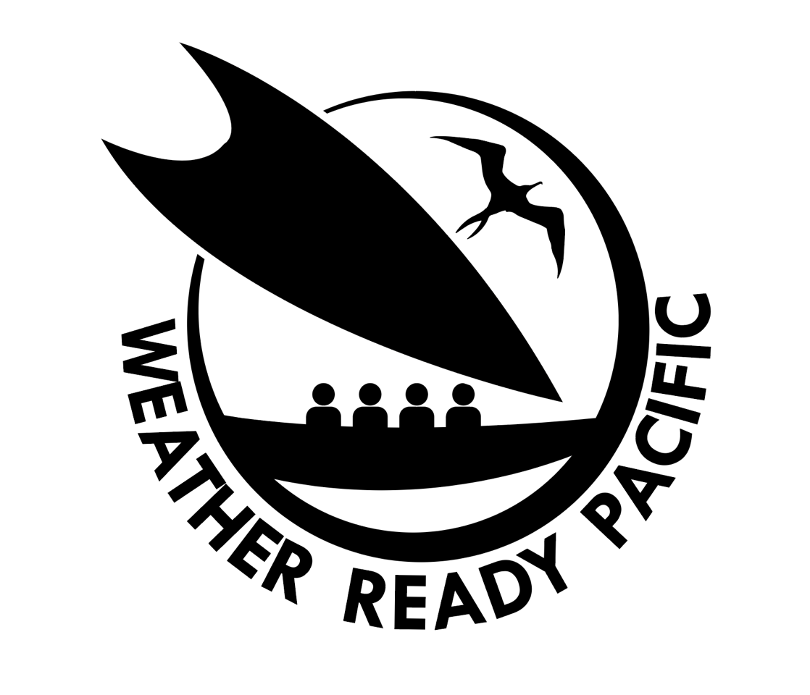
Option two – black and white

Slide 7
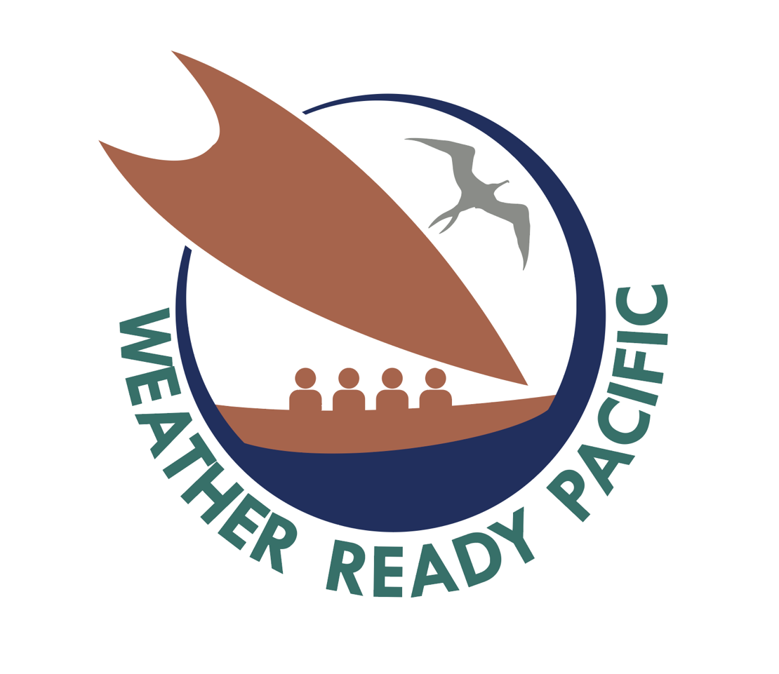
Option two – colour

Slide 8
Option one explanation
Circle wave exterior – Symbolic of hazards we all of our Pacific islands face such as king tides, tsunami, sea level rise and so forth. Reflecting it as a circle encompassing the logo represents how our ocean surrounds our Pacific islands. This is a key feature of our logo as large ocean island states.
Vaka – Represents our Pacific people, our history, how our people are steering and leading our resilience on this journey through the Weather Ready Pacific, as our ancestors navigated their journey to new lands.

Slide 9
Option one explanation cont’d
Frigate Bird – Represents our Early warnings and our traditional knowledge, as the most common traditional indicator in the Pacific for Early warning. Many of our Pacific Islanders as young children know the meaning of this bird.
Interlinked tiare – Symbolic of our Pacific people welcoming a Resilient Pacific and our unity as we hope for a Resilient Pacific with the dawning of each day.
Passengars in the vaka – Four people represent the community and the four Pillars of Early Warning for All.

Slide 10
Option two explanation
Circle wave exterior – Symbolic of hazards we all of our Pacific islands face such as king tides, tsunami, sea level rise and so forth. Reflecting it as a circle encompassing the logo represents how our ocean surrounds our Pacific islands. This is a key feature of our logo as large ocean island states.
Vaka – Represents our Pacific people, our history, how our people are steering and leading our resilience on this journey through the Weather Ready Pacific, as our ancestors navigated their journey to new lands.

Slide 11
Option two explanation cont’d
Frigate Bird – Represents our Early warnings and our traditional knowledge, as the most common traditional indicator in the Pacific for Early warning. Many of our Pacific Islanders as young children know the meaning of this bird.
Passengars in the vaka – Four people represent the community and the four Pillars of Early Warning for All.

Slide 12
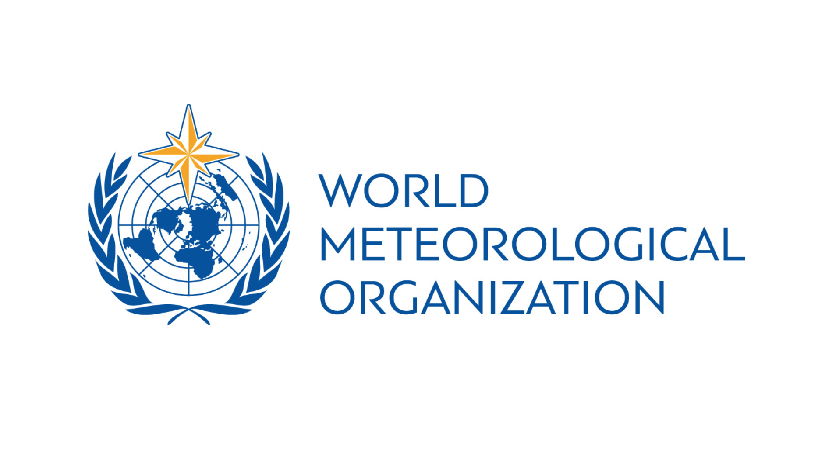

Logo line up examples

Slide 13
How to vote
On your ballot please write the name of the option you would prefer.
Option 1 Option 2

Slide 14
Thank you!

